Slide 1
FRESHMEN YEAR MAKING IT COUNT
Notes:
‹#›

Slide 2
OMHS Guidance and Counseling Center
How do I see my counselor?
Stop by and make an appointment
Parents can phone the office
682-5201
Email – email links can be found on the OMHS website

Slide 3
High School Vocabulary 101
Transcript
Credits (AKA Carnegie Units)
Quality Points
Grade Point Average
Weighted vs. Unweighted GPA
Term GPA vs. Cumulative/Rank GPA
Core Courses
Honor and Advanced Placement (AP) Courses
Dual Enrollment/Dual Credit Courses DE/DC
Elective Courses
Notes:
Beginning course details and/or books/materials needed for a class/project.
‹#›

Slide 4
High School Vocabulary 101
Transcript
Your high school transcript records all of the courses you have taken during high school, including the grades you earned and the credit awarded.
Credits, grades (GPA), and quality points are reported at the end of each semester.

Slide 5
High School Vocabulary 101
Credits
You earn ½ credit for each class you pass at the end of every semester. You can earn up to 3.5 credits per semester.

Slide 6
High School Vocabulary 101
Quality Points
The numeric value awarded to grades within a certain range:
Letter Grade | Numeric Range | Quality Point assigned for regular classes | Quality Point assigned for honors classes | Quality Point assigned for AP classes
A B C D F | 90+ 80-89 70-79 60-69 0-59 | 4 3 2 1 0 | 4.5 3.5 2.5 1.5 0 | 5 4 3 2 0

Slide 7
High School Vocabulary 101
Remember…
You earn ½ extra quality point for honors classes.
You earn 1 extra quality point for AP classes.
You get ½ extra point for DE/DC classes

Slide 8
High School Vocabulary 101
GRADE POINT AVERAGE
Unweighted GPA – GPA is calculated by dividing the number of quality points earned by the number of classes taken with no extra weight added for any classes.
Weighted GPA – The GPA earned when extra weight for honors and AP classes is included

Slide 9
High School Vocabulary 101
GRADE POINT AVERAGE
Semester/Term GPA – Includes classes taken during one semester
Cumulative/ Rank GPA – Includes all classes taken since the 1st semester of 9th grade
Notes:
Relative vocabulary list.
‹#›

Slide 10
High School Vocabulary 101
Core Classes – Required classes everyone has to pass
Honor and AP Classes–Advanced and College Level Courses
Dual Enrollment/Dual Credit Classes DE/DC– College classes that earn a credit for high school and college (Jefferson State Community College)
Elective Classes- Courses you “elect” to take outside of the CORE requirements
Notes:
A list of procedures and steps, or a lecture slide with media.
‹#›

Slide 11
Why Grades Matter?
If you plan on going to college, then GPA matters! You have 6 semesters (First and Second semesters of your 9th, 10th, and 11th grade years) before you send your transcript to the colleges to which you are applying.
Notes:
A list of procedures and steps, or a lecture slide with media.
‹#›

Slide 12
Why Grades Matter?
Your semester average (the actual grade that goes on the transcript) is configured in the following manner:
1st Semester | 2nd Semester
1st- Nine Weeks at 40% | 3rd - Nine Weeks at 40%
2nd- Nine Weeks at 40% | 4th - Nine Weeks at 40%
1st Semester Exam at 20% | 2nd Semester Exam at 20%
= 1st Semester Average | = 2nd Semester Average
Notes:
A list of procedures and steps, or a lecture slide with media.
‹#›

Slide 13
Why Grades Matter?
Shelby County Schools utilizes a district-wide grading system. Grades will be divided into 3 weighted categories:
Gold- 60% of the student’s 9-Week Grade: This category consists of major assignments, tests, and projects
Silver- 30% of the student’s 9-Week Grade: This category consists of quizzes, assignments that build to a 60% project or paper, collaborative work, lab reports, class work, etc.
Bronze- 10% of the student’s 9-Week Grade: This category consists of homework, bell ringers, study guides, etc.

Slide 14
Also keep in mind…
To be able to participate in extracurricular activities including athletics, you must meet Shelby County’s “Academics First” policy and the AHSAA guidelines:
Eligibility for grades 8 & 9- The student must pass 5 subjects with an average of 70 or higher in these 5 courses during the previous school year.
Eligibility for grades 10-12- The student must maintain a passing grade in at least 6 credit courses from the preceding year and earn an average of 70 or higher. Of these 6 classes, 4 credits must be earned in core subject area classes.
Notes:
Conclusion to course, lecture, et al.
‹#›

Slide 15
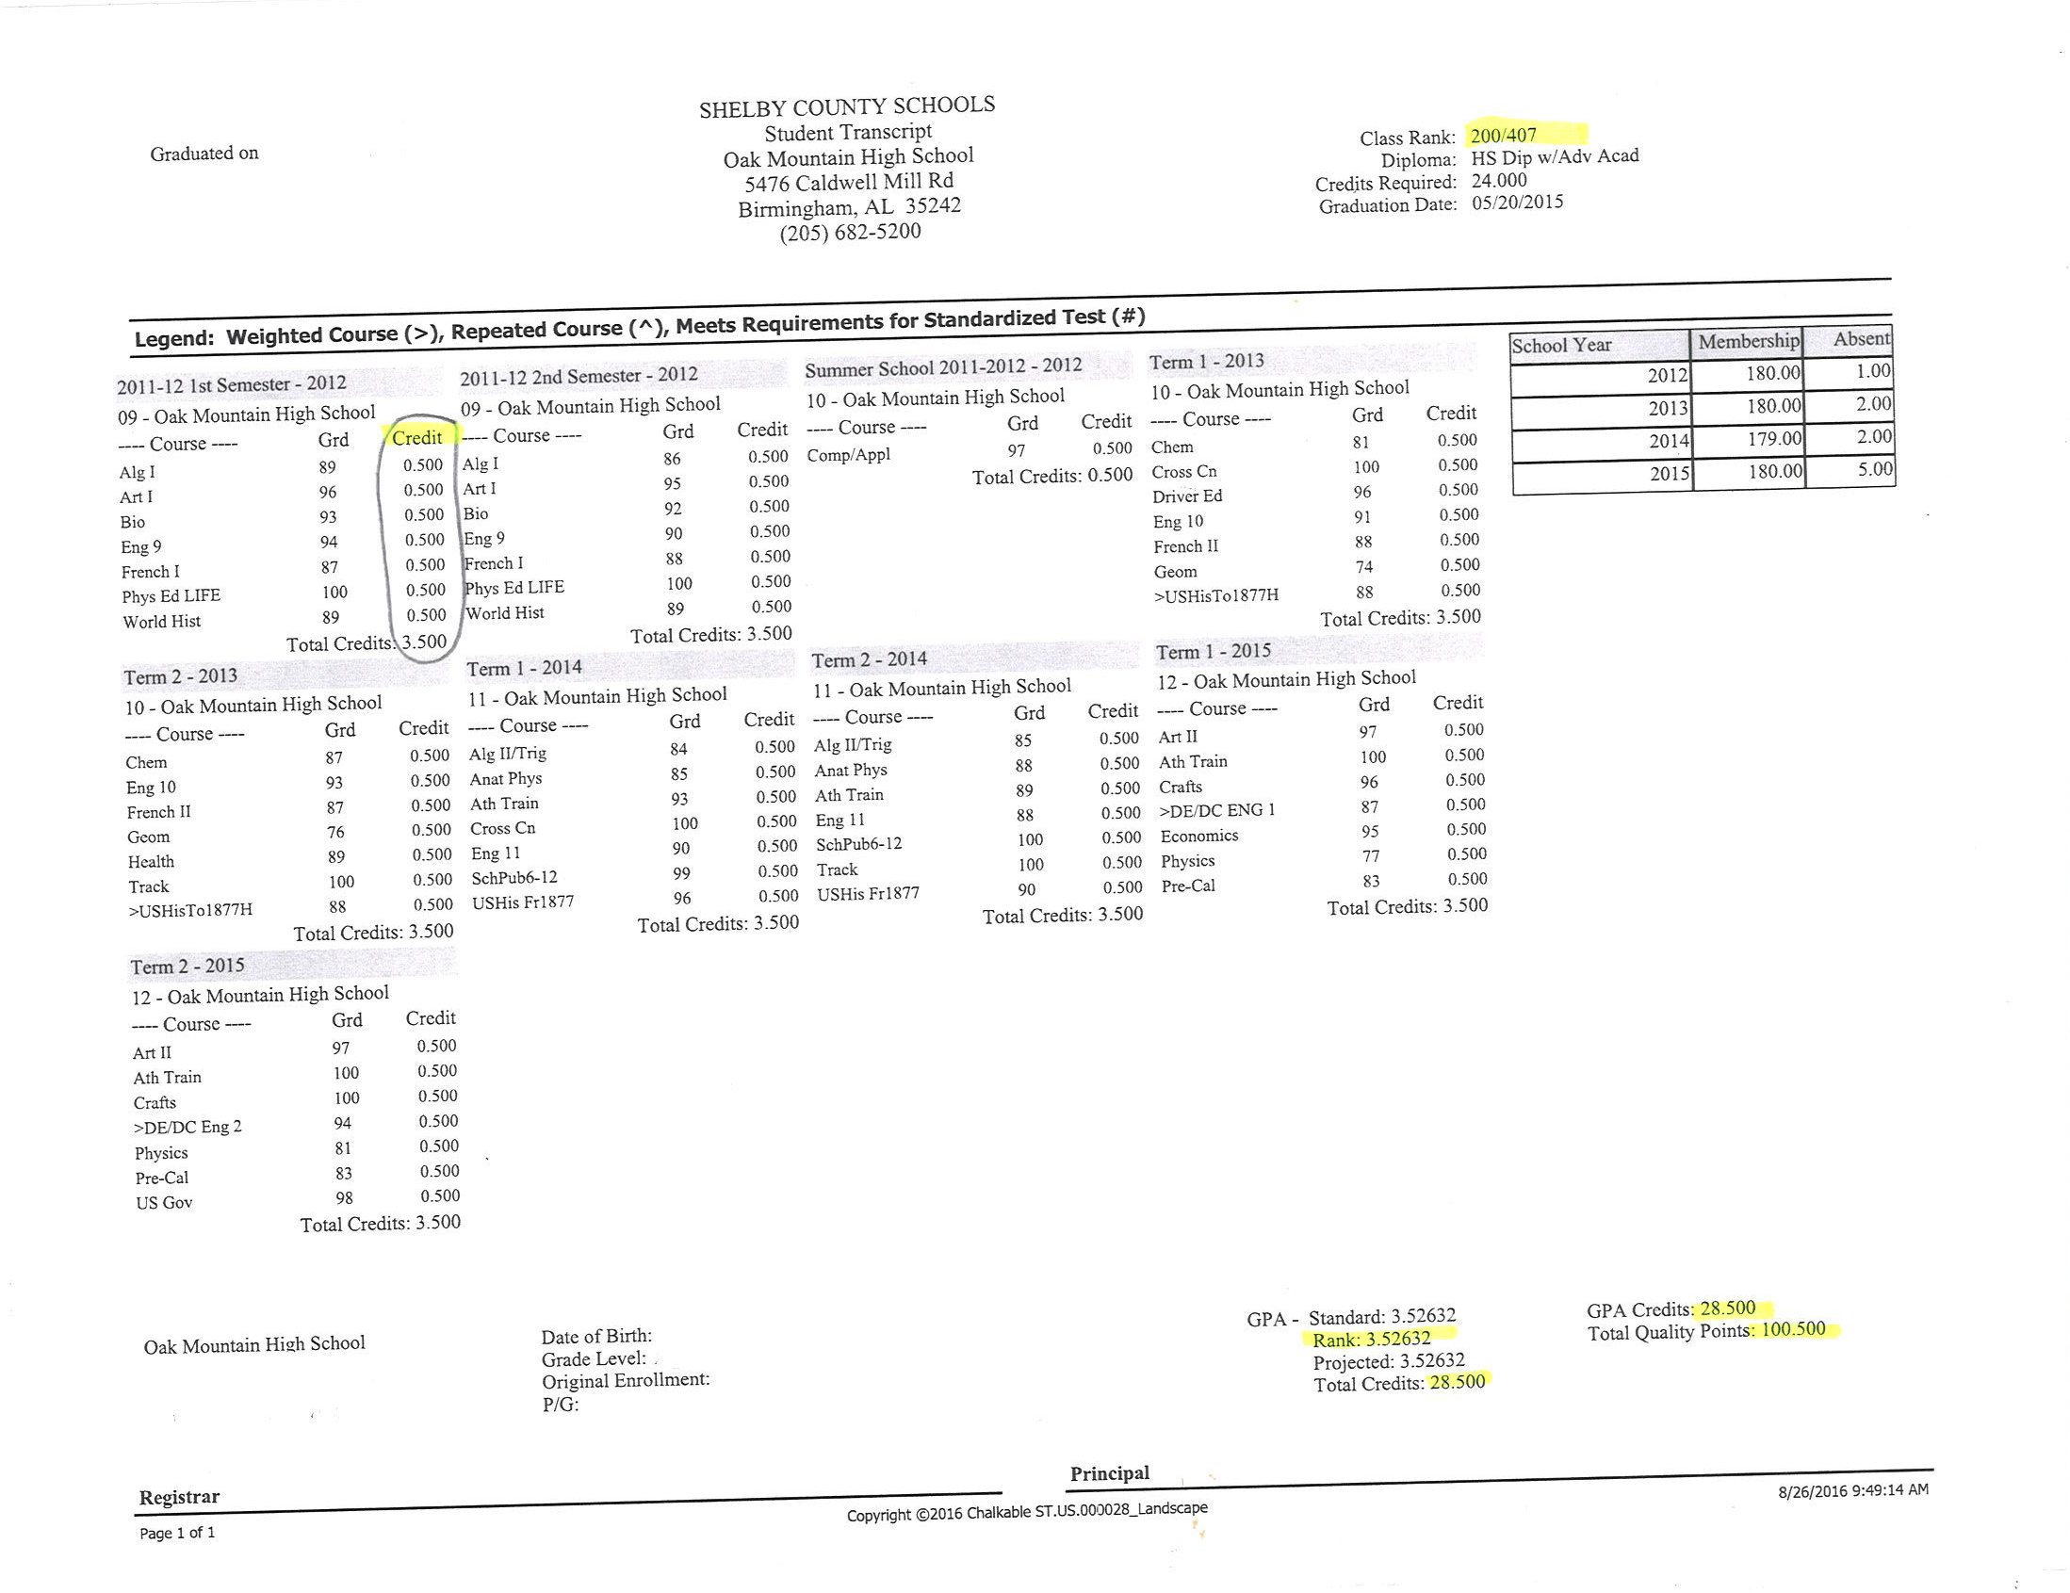
Let’s Practice…
Notes:
Conclusion to course, lecture, et al.
‹#›

Slide 16
Let’s Practice…
Donald has the following grades. Calculate his semester average in Geometry…
Geometry
1 9W = 75
2 9W = 92
Exam = 79
Notes:
Conclusion to course, lecture, et al.
‹#›

Slide 17
Let’s Practice…
Donald has the following grades. Calculate his semester average in both classes…
Geometry
1 9W = 75 (.40)=30
2 9W = 92 (.40)=36.8
Exam = 79 (.20)=15.8
Sem. Avg.= 82.6=83
Notes:
Conclusion to course, lecture, et al.
‹#›

Slide 18
Let’s Practice…
Hillary earned the following grades this semester. Calculate her semester GPA…
AP English 11 =78
Hon Alg. 2 with Trig = 89
AP US History 11 = 92
PE Lifetime Sports = 100
Environmental Science = 69
Dual Enrollment Psychology = 95
Notes:
Conclusion to course, lecture, et al.
‹#›

Slide 19
Let’s Practice…
Hillary earned the following grades this semester. Calculate her semester GPA…
AP English 11 =78 3.0
Hon Alg. 2 with Trig = 89 3.5
AP US History 11 = 92 5.0
PE Lifetime Sports = 100 4.0
Environmental Science = 69 1.0
Dual Enrollment Psychology = 95 4.5
Total= 21/6= 3.50

Slide 20
Let’s Practice…
Larry is a 10th grade student who wants to participate in the Debate Club. In 9th grade he earned…
English S1=70; S2=80 Composite Average: 81.2 = 81
Social Studies S1=80; S2=90
Science S1=61; S2=79
Math S1=59; S2=58
PE S1=100; S2=100
Art S1=90; S2=95
Career Prep S1=85; S2=90

Slide 21
Let’s Practice…
Larry is a 10th grade student who wants to participate in the Debate Club. In 9th grade he earned…
English S1=70; S2=80 Composite Average: 81.2 = 81
Social Studies S1=80; S2=90
Science S1=61; S2=79
Math S1=59; S2=58
PE S1=100; S2=100 This student failed a
Art S1=90; S2=95 CORE class, therefore
Career Prep S1=85; S2=90 he is ineligible!!

Slide 22
Questions???????

